Slide 1
Online Chatbot Based Ticketing System For Museum
CSE7301 Capstone Project
Review-3
Batch Number:
Under the Supervision of,
Mr. Syed Mohsin
School of Computer Science and Engineering
Presidency University
Roll Number | Student Name
20211CSE0631 | Prashanth S N
20211CSE0666 | Nithin H M
20211CSE0889 | Kanala Krishna Samhith
Name of the Program: CSE
Name of the HoD: Dr. Asif Mohammed H.B
Name of the Program Project Coordinator: Mr. Syed Mohsin
Name of the School Project Coordinators: Dr. Sampath A K / Dr. Abdul Khadar A / Mr. Md Ziaur Rahman

Slide 2
Content
Introduction
Literature Survey
Objectives
Existing Methods-Drawbacks
Proposed Method
Architecture Diagram

Slide 3
Content
Live Chatbots For Ticketing System
Drawbacks Of Chatbot Ticketing System
Modules
Hardware and Software Details
Time Line by Gantt Chart
GitHub Link
References

Slide 4
Introduction
Manual ticketing systems in museums often result in long queues, inefficiencies, and errors that negatively impact the visitor experience. During peak hours, weekends, and special events, these issues become more prominent, leading to customer dissatisfaction and operational delays. Inaccurate ticket issuance, double bookings, and lost records further strain the system, damaging both reputation and revenue.
To overcome these challenges, this project proposes an AI-powered chatbot-based ticketing system that automates the entire booking process—from gate entries to event passes. The chatbot offers a seamless, conversational interface for users to book, cancel, and manage tickets, while also integrating with secure payment gateways for end-to-end automation.

Slide 5
Literature Survey
Highlights the use of chatbots in customer service and ticketing systems in travel and tourism.
Examines existing ticket booking systems in museums, focusing on manual and online systems.
Focuses on how chatbots can enhance user experience and accessibility in cultural institutions.
Discusses the role of multilingual capabilities in enhancing chatbot effectiveness for international users.
Focuses on the role of chatbots in enhancing user experience in web-based systems.

Slide 6
Literature Survey
Key Technologies Explored:
MERN Stack: MongoDB, Express.js, React, Node.js used for full-stack development. (Link)
Relevant Works:
Chatbot-based ticketing in airlines: Reference: https://ieeexplore.ieee.org/document/9058283
Tourism chatbot case studies: Reference: https://www.sciencedirect.com/science/article/pii/S1877050920304041

Slide 7
Literature Survey
Key Findings:
Existing systems lack in multilingual conversation continuity, especially in regional Indian languages.
Few ticketing bots integrate real-time availability and refund logic.
Museum/tourism ticketing bots are rare compared to airlines and movies only for user guidance not for booking a ticket.

Slide 8
Objectives
Develop a chatbot capable of handling ticket bookings for museum entry and shows.
Implement multilingual support for global visitors.
Create an analytics dashboard to collect and analyze user data for operational insights.
Dynamic ticketing process to reduce human errors and improve efficiency.
Integrate a payment gateway for secure online payments.

Slide 9
Existing Methods
Manual Ticket Counter
Long queues and human errors.
Mobile Apps
Require app downloads, device compatibility issues.
Email or Phone-based Ticketing
Manual data entry, prone to errors.

Slide 10
Live Existing Chatbot Ticketing System
Ask Disha 2.0 (IRCTC Ticket Booking Bot)
Red Bus Chatbot (platform: whatsapp)
Bookmyshow Chatbot (platform: whatsapp)
KLM Royal Dutch Airways (Bluebot)
Lufthansa Bot (Lufthansa Chat Assistant)

Slide 11
Live Existing Chatbot Ticketing System For Museums
Louvre Museum, Paris ( platform: Louvre Museum )
Jewish Historical Museum, Amsterdam ( cultural chatbot: a virtual museum tour guide )
Museu do Amanhã, Rio de Janeiro ( chatbot: IRIS+)
National Art Museum of the Republic of Belarus, Minsk ( platform: Facebook messenger bot )

Slide 12
Drawbacks For Existing Methods
Inefficiency & Long Wait Times
Human Errors in Ticketing
Lack of Real-time Data
Limited Customer Support
Scalability Issues
Accessibility Problems
High Operational Costs

Slide 13
Drawbacks In Chatbot Ticketing System
Limited understanding of complex queries - contextual or ambiguous questions leads to incorrect response
Technical glitches and errors - system failure or bugs in NLP leads to incorrect response
Security and privacy concerns - for handling private transactions

Slide 14
Drawbacks In Chatbot Ticketing System
Dependency over internet and technology - requires stable internet
Limited multilingual support - fail to accurate translate queries, especially for non- mainstream languages

Slide 15
Proposed Method
Step-by-Step Booking Flow
Improved Customer Service
Efficient Handling of High Volumes
Cost-Effective Solution
Data Collection and Analysis
Accessibility and Reduced Human Error
Secure Payment Gateway(Rasorpay)
Enhanced Marketing and Promotion

Slide 16
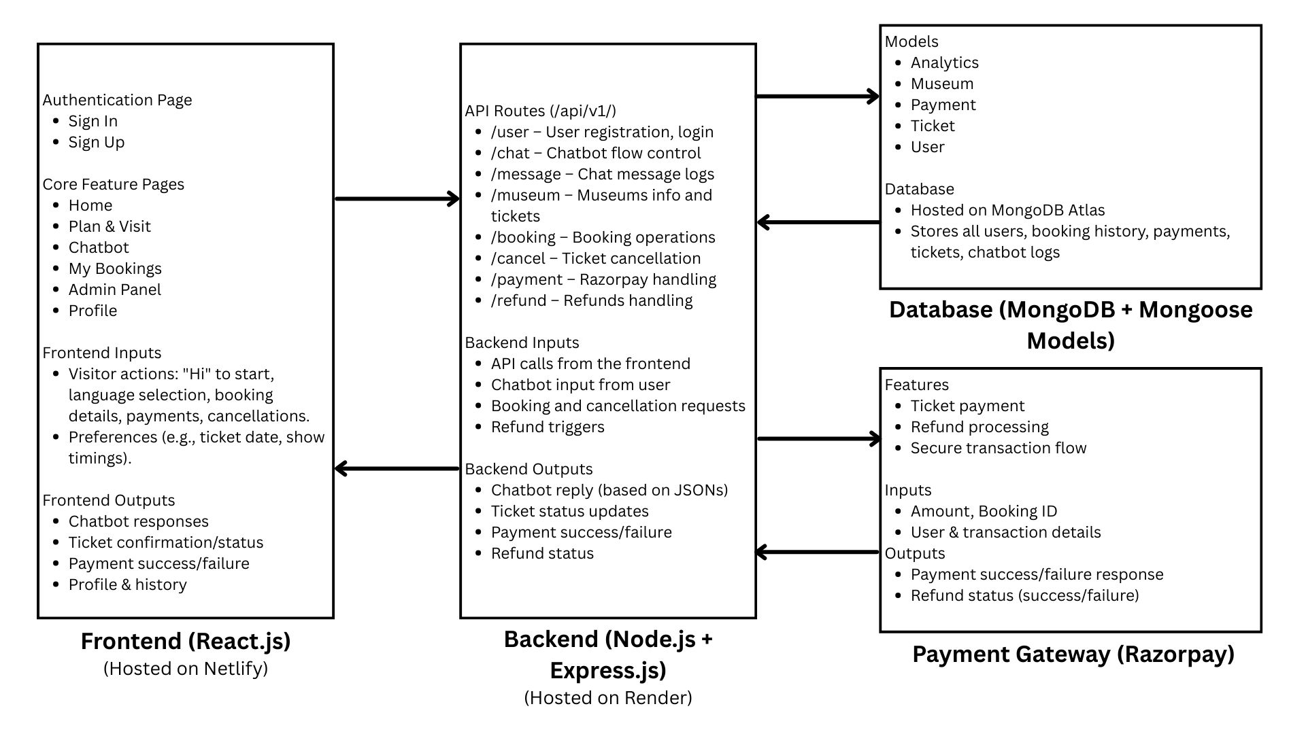
Architecture Diagram

Slide 17
Modules
Chatbot Module: Handles user interactions, queries, and booking confirmations.
Database Module: Stores visitor data, ticket information, and transaction details.
Analytics Module/ Admin Panel : Collects user data and generates insights for museum management(ex: Dashboard, Manage Users, Manage Tickets, Manage Payments, Manage Museums)
Payment Module: Manages transactions through secure gateways.

Slide 18
Hardware and Software Details
Software Requirements:
Operating System
Windows, macOS, or Linux: Any modern OS capable of running development environments.
Development Environment
Code Editor: Visual Studio Code.
Node.js: For back-end development and running JavaScript on the server side.
Database Management Tool: MongoDB.
Version Control
Git: For managing version control and collaboration.
GitHub: For hosting the repository.

Slide 19
Hardware and Software Details
Hardware Requirements:
Development Machine
Processor: Intel i5 (or equivalent AMD) or higher.
RAM: 8GB or more for handling multiple tasks such as running the local server, browser, and development tools simultaneously.
Storage: 256GB SSD or more for faster performance and to handle development tasks quickly.
Internet Connection
Stable broadband connection for accessing APIs, cloud storage, and deploying the application to cloud platforms.

Slide 20
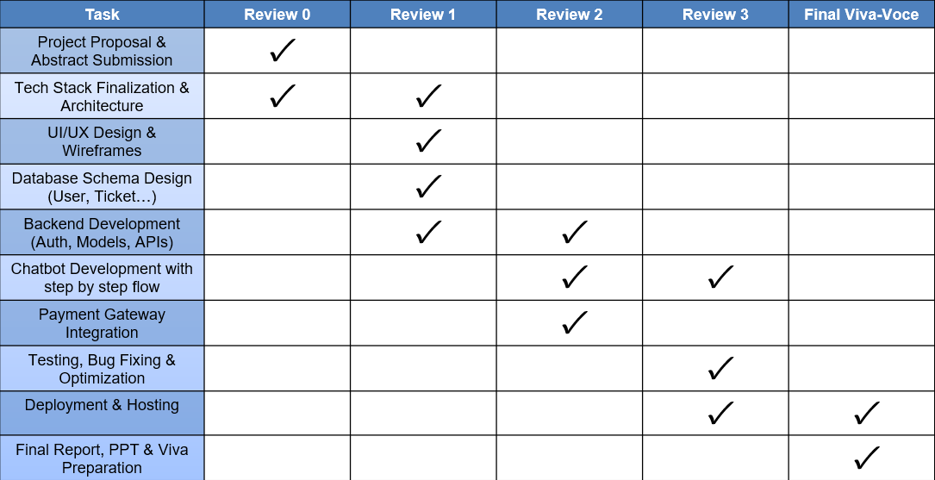
Timeline of the Project (Gantt Chart)

Slide 21
Github Link
The Github link provided should have public access permission.
Github Link
https://github.com/Prashanth0718/ONLINE-CHATBOT-TICKETING-SYSTEM

Slide 22
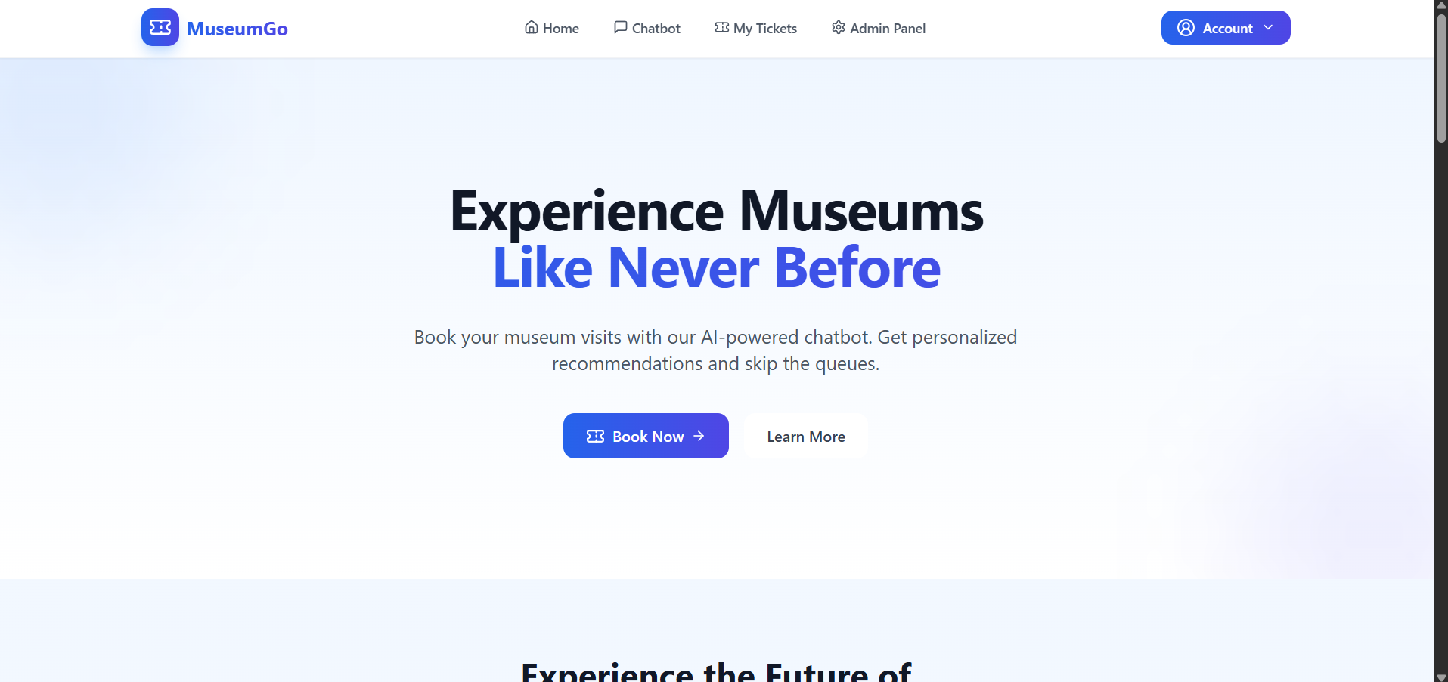
Outcomes :

Slide 23
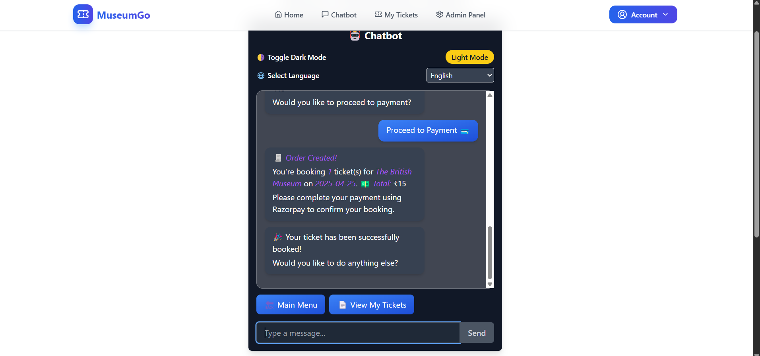
Outcomes :

Slide 24
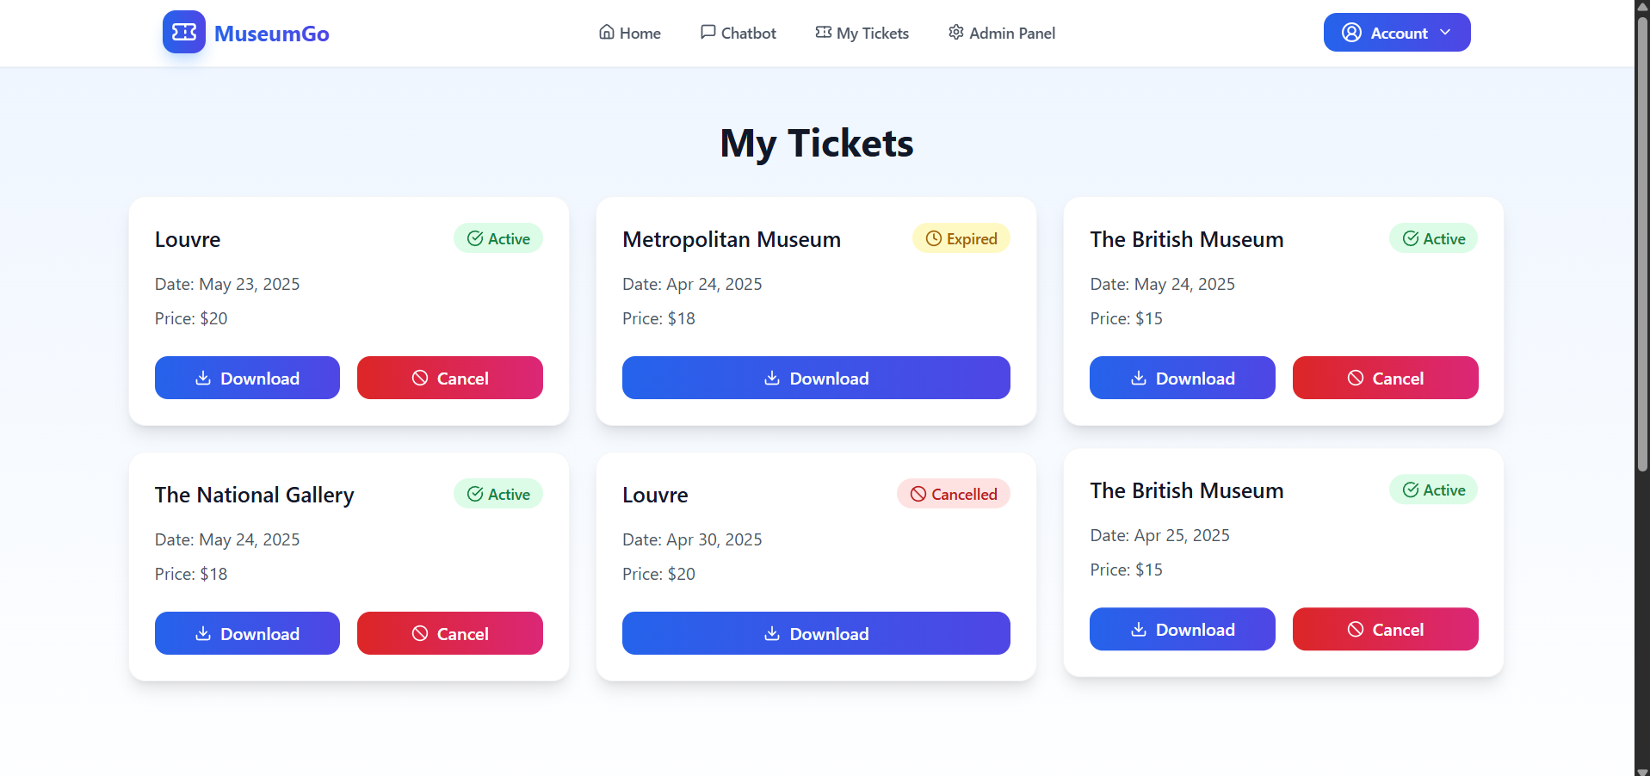
Outcomes :

Slide 25
References(Referring Research Papers)
[1] Chatbots in Tourism Industry: A Survey (Link)
https://www.sciencedirect.com/science/article/pii/S1877050919310360
[2] A Study of Ticket Booking Systems in Museums (Link)
https://www.researchgate.net/publication/323908463_TiteleiInhaltsverzeichnis
[3] Natural Language Processing (NLP) for Customer Service Chatbots (Link)
https://www.researchgate.net/publication/341501101_Natural_Language_Processing_for_Customer_Service_Chatbots
[4] Exploring Chatbots in the Context of Museums and Cultural Heritage Sites (Link)
https://www.sciencedirect.com/science/article/pii/S187705091930960X
[5] Multilingual Support in Chatbots for Global Customer Engagement (Link)
https://www.sciencedirect.com/science/article/pii/S187705091930960X
[6] Machine Learning-Based Automated Ticketing System (Link)
https://www.researchgate.net/publication/329366058_Machine_Learning_Based_Automated_Ticketing_System
[7] Chatbot-Driven Customer Service Automation: A Review (Link)
https://www.researchgate.net/publication/334425199_Chatbot-driven_Customer_Service_Automation_A_Review
[8] A Comparative Analysis of Payment Gateways for E-Commerce (Link)
https://www.sciencedirect.com/science/article/pii/S1877050919310966
[9] Improving User Experience in Web Applications Using Chatbots (Link)
https://www.researchgate.net/publication/335562545_Improving_User_Experience_in_Web_Applications_Using_Chatbots

Slide 26
Thank-You

